Slide 1

BLUETOOTH BASED HOME AUTOMATION
BATCH NUMBER :20 1.18R11A0254– Y.PRASANNA 2. 18R11A0241 –N.SRUTHI KEERTHANA 3. 18R11A0216– E.ARAVIND KUMAR
GUIDE NAME : CH.ADITYA
Department of Electrical and Electronics Engineering
GEETHANJALI COLLEGE OF ENGINEERING AND TECHNOLOGY (UGC AUTONOMOUS)
Cheeryal (V), Keesara (M), Medchal District, Hyderabad– 501 301
(Approved by AICTE, Permanently Affiliated to JNTUH, Accredited by NBA, Accredited by NAAC
with “A” Grade and ISO 9000:2015 Certified)

Slide 2
Contents
AIM OF THE PROJECT
BLOCK DIAGRAM
MODULES DESCRIPTION
ADVANTAGES AND DISADVANTAGES
APPLICATIONS
CONCLUSION

Slide 3
AIM OF THE PROJECT
With the advancement of technology and more dependency of people on smart phone and increasing demands of easy and quick way of solving daily life tasks.
In this project we present home automation based on Bluetooth.
The main aim of this project is to develop a smart home automation system, which uses Bluetooth technology that will control the operation of these appliances with respect to the command sent by the Android mobile.

Slide 4
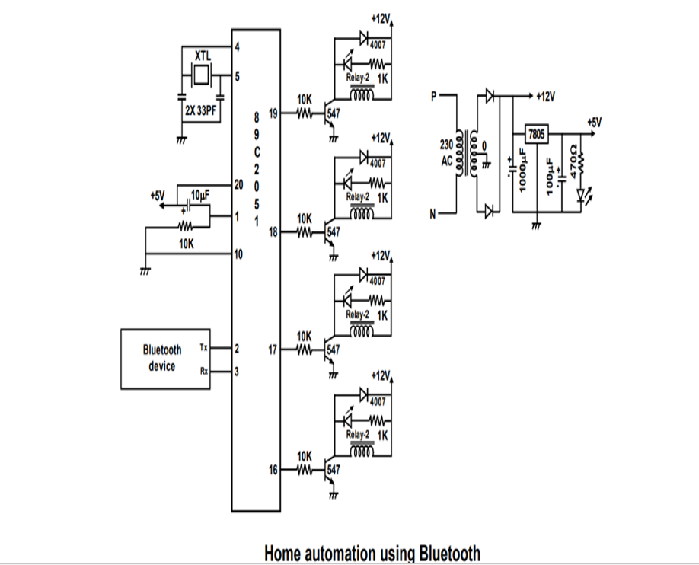
BLOCK DIAGRAM

Slide 5
MODULES
1 – Arduino processor
2 – LCD
3 – Voltage regulator
4 – LM35 sensor
5 – LDR
6 – ESP8266 microcontroller
7- Relay
8- Bluetooth Module

Slide 6
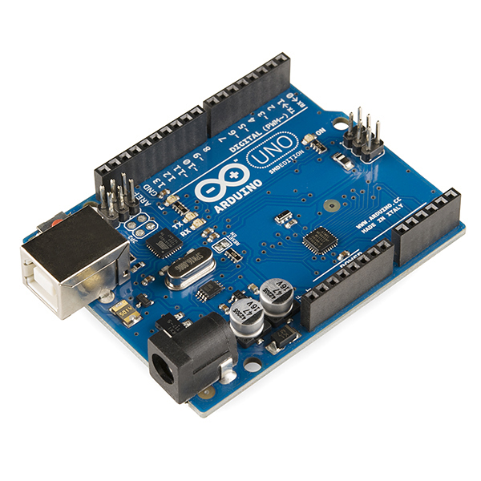
ARDUINO PROCESSOR
The Arduino Uno is a microcontroller board based on the ATmega328. It has 14 digital input/output pins (of which 6 can be used as PWM outputs), 6 analog inputs, a 16 MHz ceramic resonator, a USB connection, a power jack, an ICSP header, and a reset button.
It contains everything needed to support the microcontroller; simply connect it to a computer with a USB cable or power it with a AC-to-DC adapter or battery to get started.

Slide 7
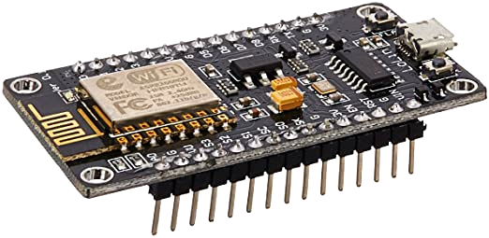
NODEMCU ESP8266
NodeMCU is an open source IoT platform, includes firmware which runs on the ESP8266 Wi-Fi Module from Espressif Systems, and hardware which is based on the ESP-12 module.
The term “NodeMCU” by default refers to the firmware rather than the development kits. NodeMCU firmware was developed so that AT commands can be replaced with Lua scripting making the life of developers easier.
The ESP8266 is a low-cost Wi-Fi chip with full TCP/IP stack and microcontroller capability produced by Shanghai-based Chinese manufacturer, Espressif.
NodeMCU (ESP8266) Development Board

Slide 8
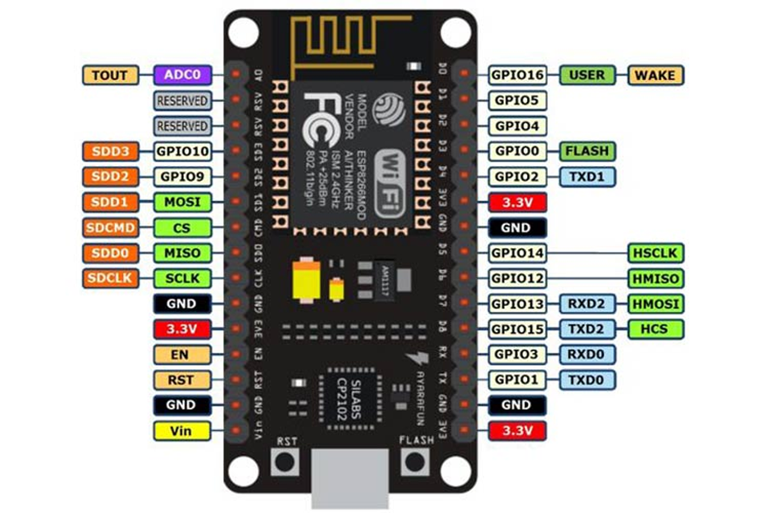
PIN DIAGRAM OF NODE MCU:

Slide 9
Applications:
Bluetooth Module
Bluetooth is the international standard of wireless communication.
It uses microwave frequency of about 2.4GHz.
Bluetooth technology uses FHSS as a way to deal with undesired interference.
Bluetooth enables us to work with verity of telephone devices such as
Mobile cellular phone to Public Switched Telephone Network (PSTN) through access point
Mobile cellular phone to notebook PC
Mobile cellular phone to headset
Communication between laptop to palm top.
This project work consists of two main modules: the android mobile phone and the Arduino BT board (Bluetooth module).
The android mobile phone consists of several Bluetooth apps which enables the user to access the home appliances and also the control commands for the appliances

Slide 10
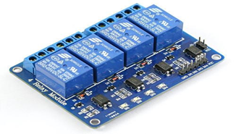
RELAY MODULE
The relays used in this project work are electromagnetic relays.
The electromagnetic relay is basically a switch (or a combination of switches) operated by the magnetic force generated by a current flowing through a coil
Essentially, it consists of four parts an electromagnet comprising a coil and a magnetic circuit, a movable armature, a set of contacts, and a frame to mount all these components.
RELAY MODULE

Slide 11
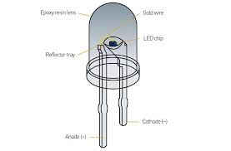
LED INDICATORS
LED’s are used as indicator lamps in many devices, and are increasingly used for lighting.
Led indicators have a life of at least ten years and consume 90 per cent less power than conventional indicators.
Depending on the type of the materials (Ga,As,p) led gives the output in different colors (red, Yellow, green etc..)

Slide 12
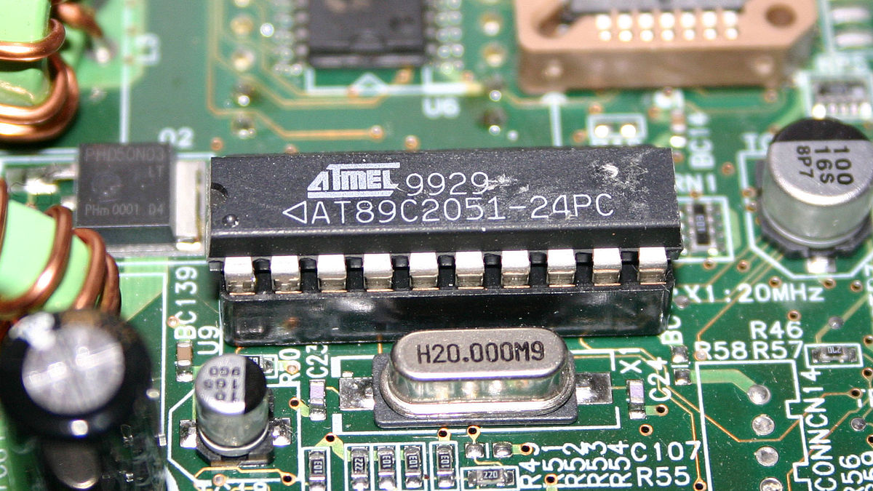
AT89C51 Microcontroller
The AT89C51 is an age old 8-bit microcontroller from the Atmel family.
It works with the popular 8051 architecture and hence is used by most beginners till date.
It is a 40 pin IC package with 4Kb flash memory. It has four ports and all together provide 32 Programmable GPIO pins.
It does not have in-built ADC module and supports only USART communication.
Although it can be interfaced with external ADC IC like the ADC084 or the ADC0808.
AT89C51 MICROCONTROLLER

Slide 13
ADVANTAGES
Managing all of your home devices from one place.
Remote control of home functions.
Fast response.
Low power consumption.
DISADVANTAGES
Limited to short distances.
It can loose connection in certain conditions.

Slide 14
APPLICATIONS :
Indoor positioning systems
Home automation for elderly and disabled people
CONCLUSION:
We have introduced design and implementation of a low cost, flexible and wireless solution to control the home appliances.
The system is secured for access from any user.
The users are expected to acquire pairing password for the Bluetooth module and the cell phone to access the home appliances.
This adds a protection from unauthorized users.

Slide 15
THANK YOU!!

